Slide 1
Trish Auletta
EDU 7901 – Advanced Educational Research Design
St. John’s University
Prof. Autumn Cyprés
Summer 2016

Slide 2
RESEARCH QUESTION
Where is the “Special” in
Educational Leadership Preparation Programs?
SBL’s perceptions of the extent to which their leadership preparation program prepared them for special education specific laws, students, and issues.

Slide 3
LITERATURE REVIEW
“Nationwide, the number of 6- to 21-year-old students classified as having autism rose 165 percent between the 2005-06 and 2014-15 school years, based on a count of nearly all states.” (Samuels, 2016)
“As special education has become more complex, it has become increasingly evident that principals need to have clear understanding of their rolls and responsibilities in this process.” (DiPaola & Walther-Thomas, 2003)
“…despite the implication for school administrators to be trained in special education laws and policies, most school administrators have received little, if any, training related to special education in their leadership preparation training (Cooner, Tochterman, & Garrison-Wade, 2000).

Slide 4
CONCEPTUAL FRAMEWORK
Participatory Openness – System Members have freedom to express need for change
Reflective Openness – Organization allow themselves to hear, understand,
and respond to what system members are saying.
Figure 1: Conceptual Framework based upon Peter Senge’s Systems Thinking

Slide 5
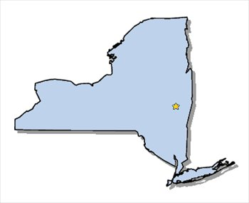
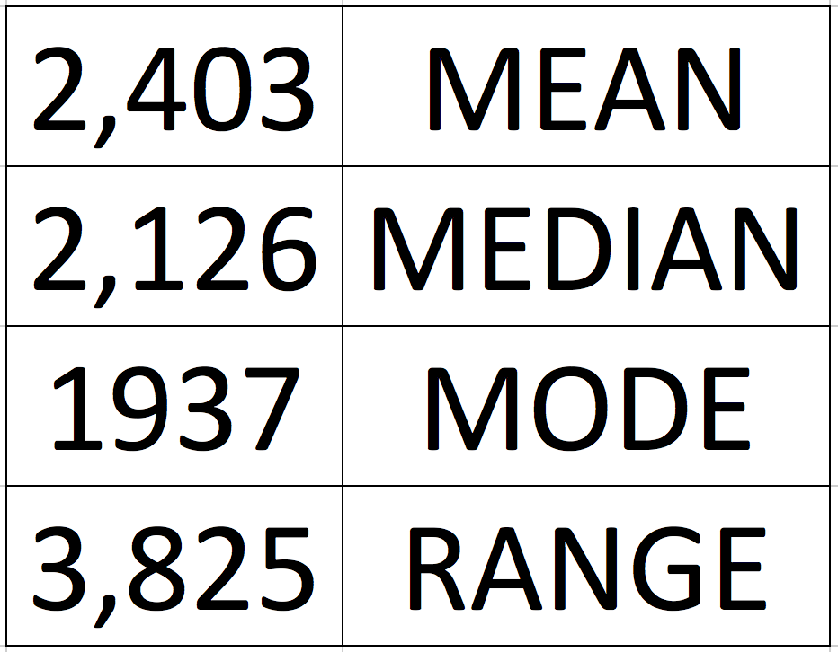
SAMPLE
High School Principals and Assistant Principals from the 100 largest public high schools in New York.
School Enrollment:

Slide 6
METHODOLOGY
Survey
Quantitative
Pre-existing & Adapted with permission
Non-experimental
51 questions:
Demographics
Perceptions about special education concepts
Knowledge of special education laws, legislation, policies, & Procedures

